Slide 1


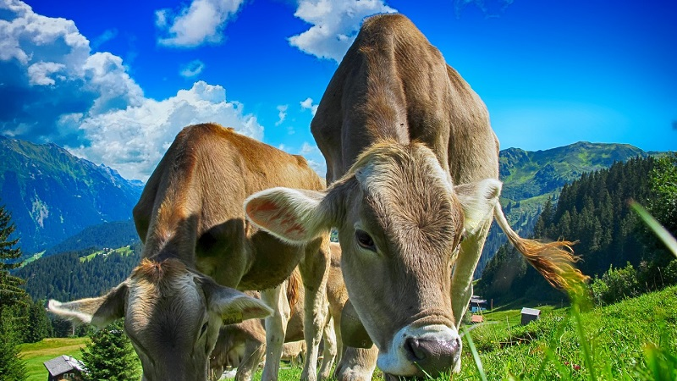
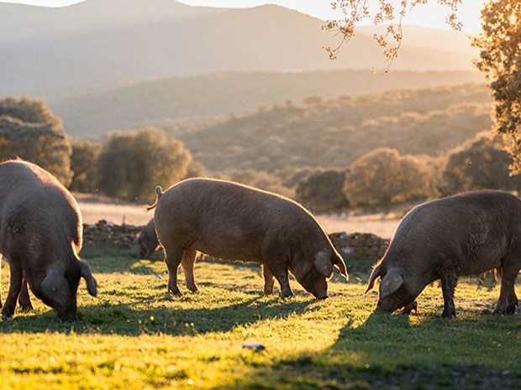
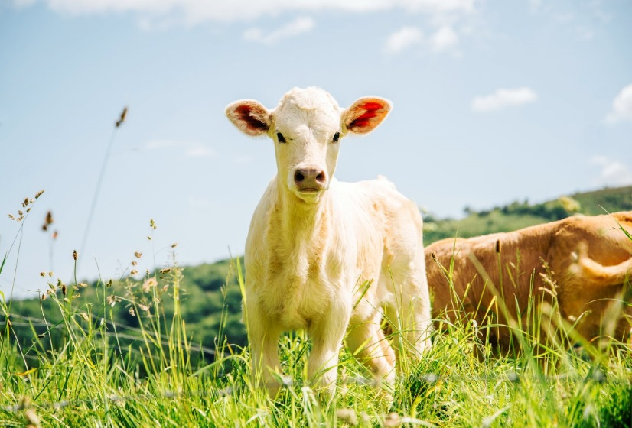
THE MEATCORNER
Panier
NOS VIANDES
Bœuf
Porc
Veau
Image Bœuf
Image Porc
Image Veau

Slide 2

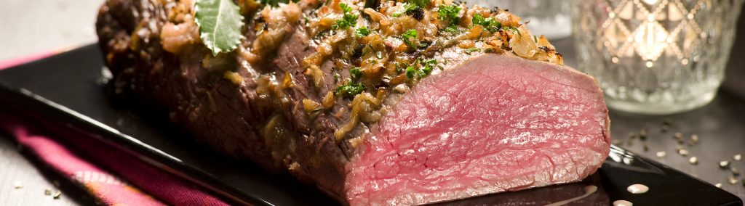
THE MEATCORNER
Panier
BŒUF

Slide 3
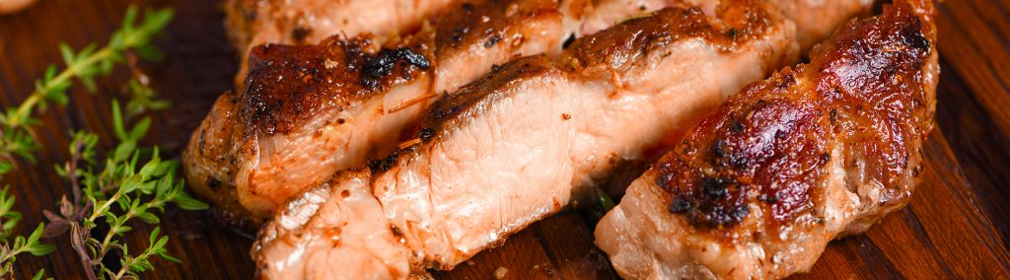
THE MEATCORNER
Panier
Porc

Slide 4
THE MEATCORNER
Panier

